Slide 1

Final Presentation

Slide 2

Introduction - company
Essity – Essentials and necessity
With sales in about 150 countries and employees of 48000 and is one of the biggest paper goods suppliers.
Consumer Tissue, Personal care and professional hygiene.
Manchester Mill is one of the main papermaking and converting plants in the UK. (1 papermaking line and 3 converting lines)
New philosophy that revolves around energy conversation and increasing automation (my main source of work)

Slide 3
Introduction – Myself
Work placement between my 3rd and 4th year from Loughborough University. Studying Electrical and Electronics Engineering.
Started out as an engineering and Installation (E&I) Intern at one of the converting lines (UK2).
Graduated to work for the continuous site improvement department, beyond the scope of the converting department.

Slide 4
Converting Operations
Manchester Mill has 3 converting lines (UK1, UT1, UK2)
Each Line has operators who work on shifts, engineers who work on days and an apprentice who works alongside the engineers.
I was set to work on the UK2 line alongside the engineers.
Daily Direction Setting (DDS) is the primary method of communication between the engineers and operators.
Main issues are outlined to the engineers and the tasks were allocated accordingly.

Slide 5
Work Undertaken
Main project was to provide an electronic visual quality control solution to mitigate the risk of defect packages. This was based on the UK2 line. Below is a list of the projects being undertaken:
Camera systems for UK2
Retroreflector sensors
Proficy Rollout
Line speed calculator for UK2
Plybond detection
Pattern and colour recognition
Spool Recognition in paper making
Training of apprentices

Slide 6

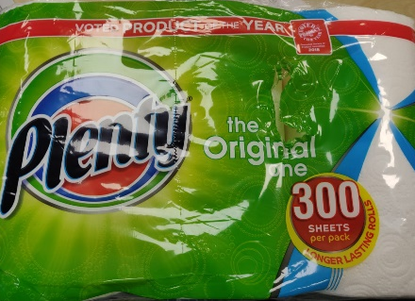
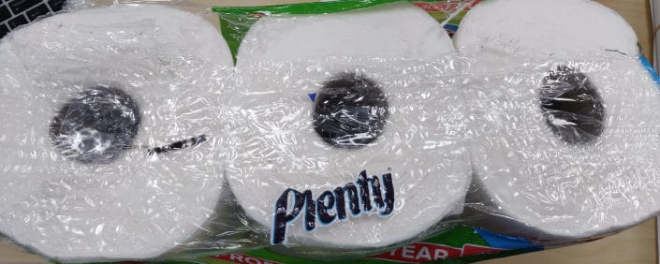
1. Camera System for UK2
Image 1: Rip at the side of the pack (outside of seal area)
Image 2: Hole at the top of the pack (seal area)
In house system was designed to tackle the issue but it did not meet quality criteria.
System was based of python using a raspberry pi and pi camera.
Keyence was contacted and problem was tried to outsource but they could not come up with a solution too.

Slide 7
Essity quality comparison
Essity Quality criteria vs python system capability.
 | Target | Minor | Major | Critical | Python system capability
Holes outside of seal area | 0 | 0 | 0 | 0 | Holes of 100mm
Holes in the seal area | 0 | Any hole < 20mm | 20mm | 40mm | Not possible to detect
Essity Quality Criteria vs Keyence camera system capability.
 | Target | Minor | Major | Critical | Python system capability
Holes outside of seal area | 0 | 0 | 0 | 0 | Rips of 50mm
Holes in the seal area | 0 | Any hole < 20mm | 20mm | 40mm | Not possible to detect
The cost estimates are provided to Essity and a decision to install them is yet to be made.

Slide 8
2.Retroreflector Sensors
The cause of the holes on the pack was found by data analysis.
One of the major causes at the sealers was due to the side sealers folding over.
Retroreflectors used to detect a fold over.
Souder beacon was also installed and the sensor sends a signal to raise an alarm when fold is detected.

Slide 9
3. Proficy Rollout
Centrelines are used to check the settings of the machines and confirming they are in range.
Operators go through all the machine settings once a day to read and record values from the HMI.
Being done manually by writing on a sheet of paper and transferring them over to an excel sheet.
Some settings were outdated and to update them, it took sometime as different products had different settings.

Slide 10
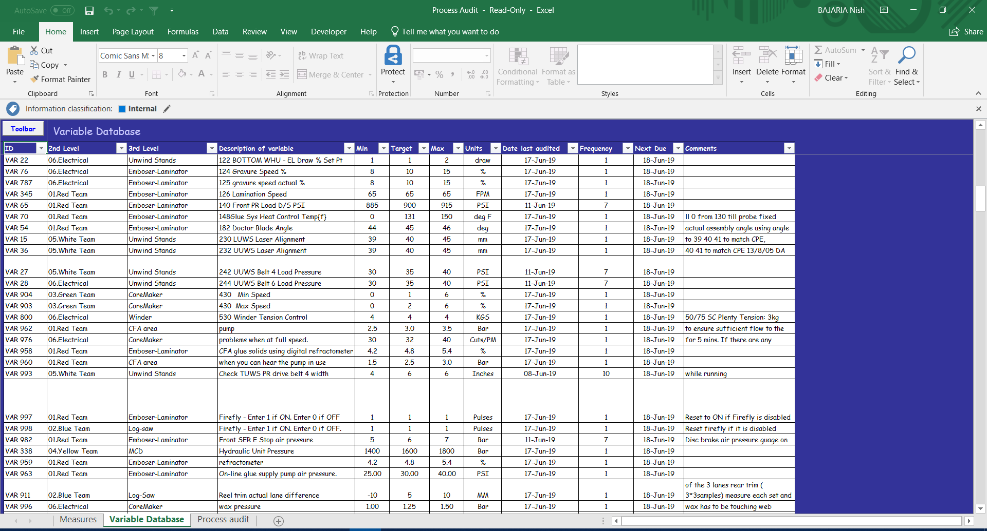

Slide 11
Excel not suitable
Having to automate the process of having all centrelines being updated from the hmi to a database It was found excel was not capable of doing it.
VBA was learnt in excel to do this, however due to vast transfer of data it caused excel to crash.

Slide 12
Proficy – General Electric
Proficy is a software developed by general electric.
It was capable of automating the process and training for the software was initiated.
All the centrelines were moved to the new system with the correct naming conventions.
This was not only implemented on UK2 but across the whole company. I was in charge of all three converting lines.

Slide 13
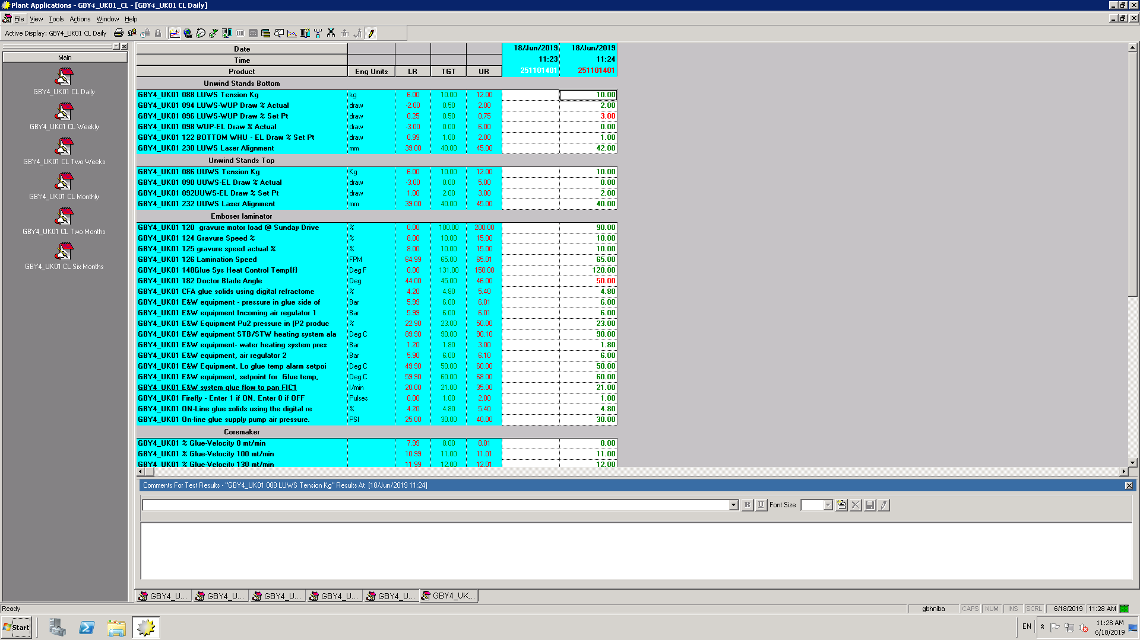
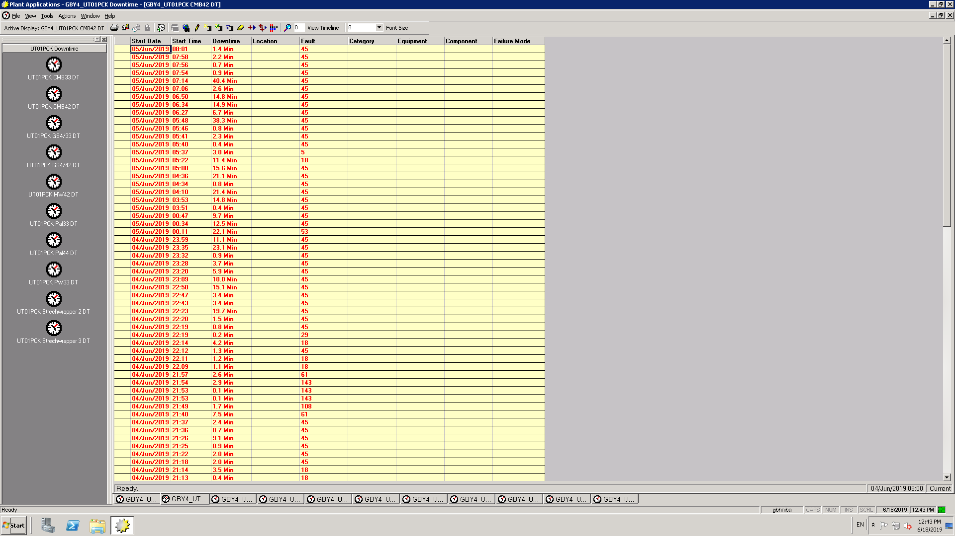
The values on the right are straight from the machines input to the database.
The screens are remotely accessible and when a value is out of range it is shown in red.
Having worked closely with the operators, usage of the new system became more evident.
The system can gather data and produce graphs to corelate between change in product and the values.
Also found that proficy had an inbuilt software that could monitor downtime.
Screens were set for each machine that displayed downtime in minutes and the fault they had.
System was evaluated and verified, training videos for the whole system were created for usage and militance of the system once the interns left the company.
The videos were approved and uploaded to the company’s training portal.
The rollout is to be carried out in July however testing with the operators was carried out seamlessly.

Slide 14
4. Line speed Calculator
The UK2 converting line was not utilizing its full potential by not having the correct line speeds. This was due to calculations of the different machines were not considered.
The UK2 is made of four key areas and bottlenecks were caused from area 2 (log saw) to area 3 (wrapper) and area 3 to area 4 (bundler).
Different speed settings were required for different product sized.
However currently a one for all setting was being implemented.
This caused the conveyers to either have excessive product (if log saw was producing at a faster rate) or have no product (log saw producing at a slower rate). This was not ideal as energy consumption was not efficient.

Slide 15
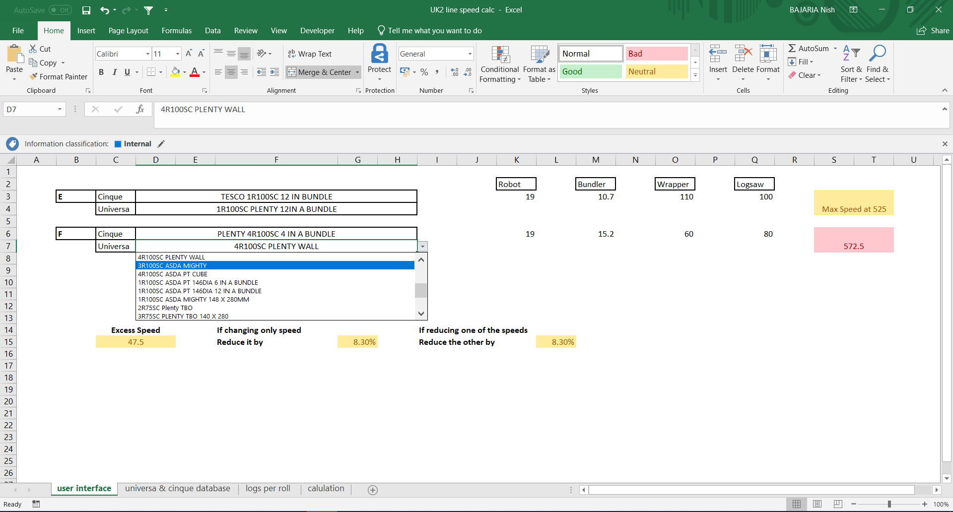
Calculations made from bundler and wrapper as maximum speed was known.
Log-saw and conveyer speed could be adjusted.
Excel spreadsheet witch each product specification was created.
Program made sure all areas were connected and a change of speed in one area didn’t affect the bottleneck and production ran efficiently.

Slide 16
5. Plybond Detection
Plybond is the term used in a papermill when two separate plies of paper are joined together.
Glue is used to combine the two plies of the parent roll to combine them. This can sometimes malfunction and have little to no glue in between the two sheets.
Calliper of a good ply and a bad ply were calculated and a noticeable difference was shown.

Slide 17
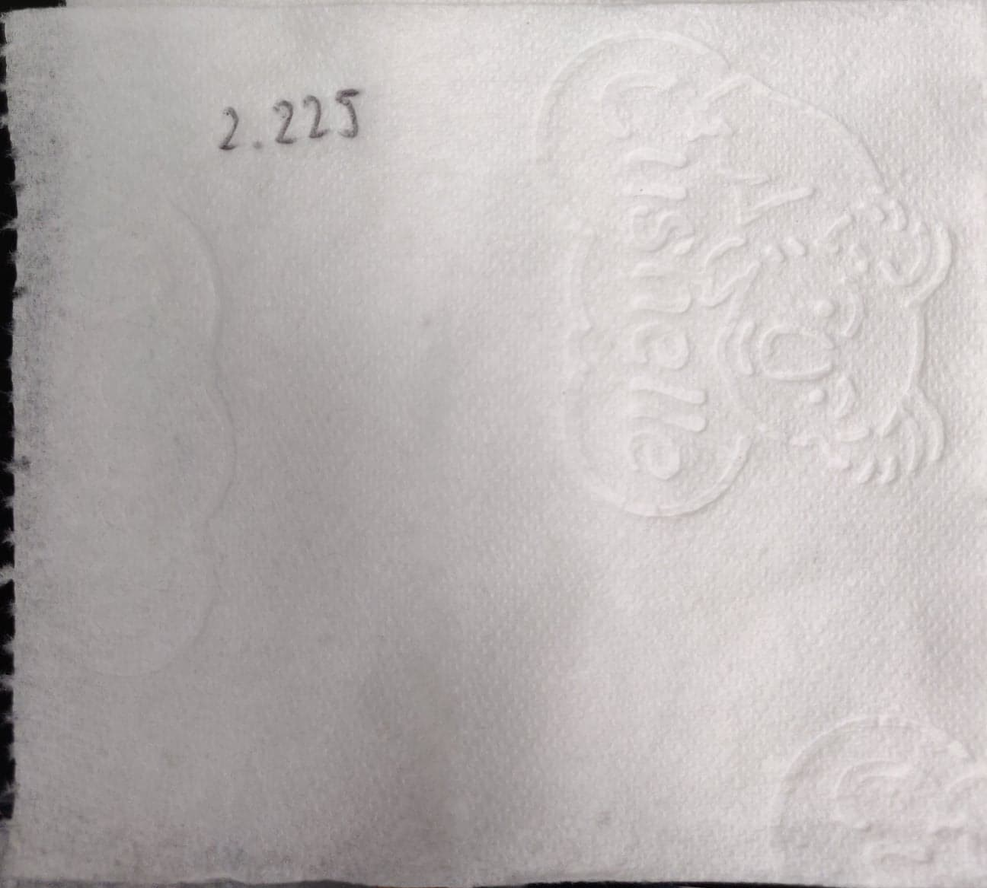
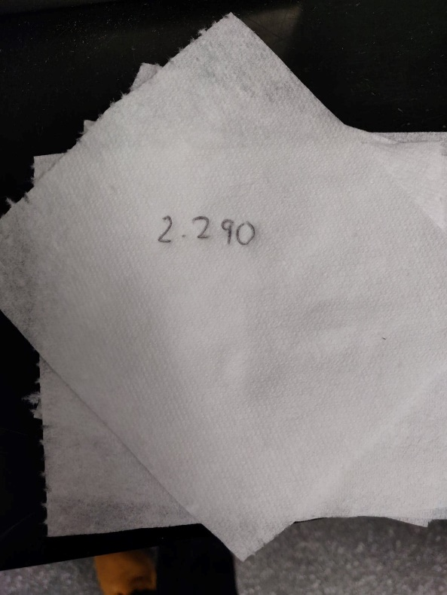
‘Good’ plybond vs ‘bad’ Plybond
Good plybond
Bad Plybond
The good plybond had a calliper of 2.225mm whereas a bad plybond had a calliper of 2.290mm.
Difference of 65 microns.
This was the worst-case scenario as the bad plybond had no glue at all.

Slide 18
Two ways of doing it.
Method 1:
Measure and Calculate the thickness of each ply before they are bonded together.
Measure and calculate the thickness of tissue once combined.
If thickness of tissue once combined greater than a certain percentage plybond is faulty.
Expensive but accurate as would require sensors at 3 stations.
2 * each ply
1 * combined
Method 2:
Measure and calculate the thickness of tissue once combined.
Compare it to a measured value previously at the lab.
If thickness of tissue once combined greater than a certain percentage plybond is faulty.
Not real time comparisons to the ply but cheaper as sensors required at 1 station.

Slide 19
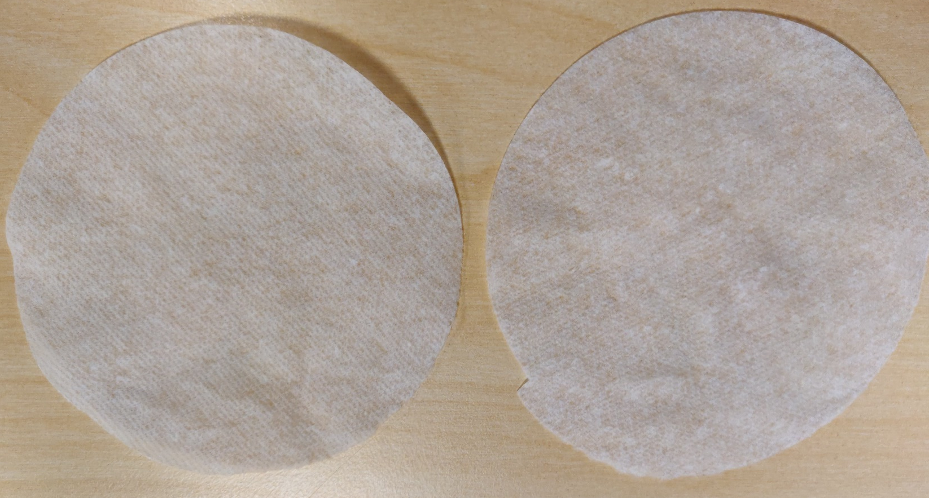
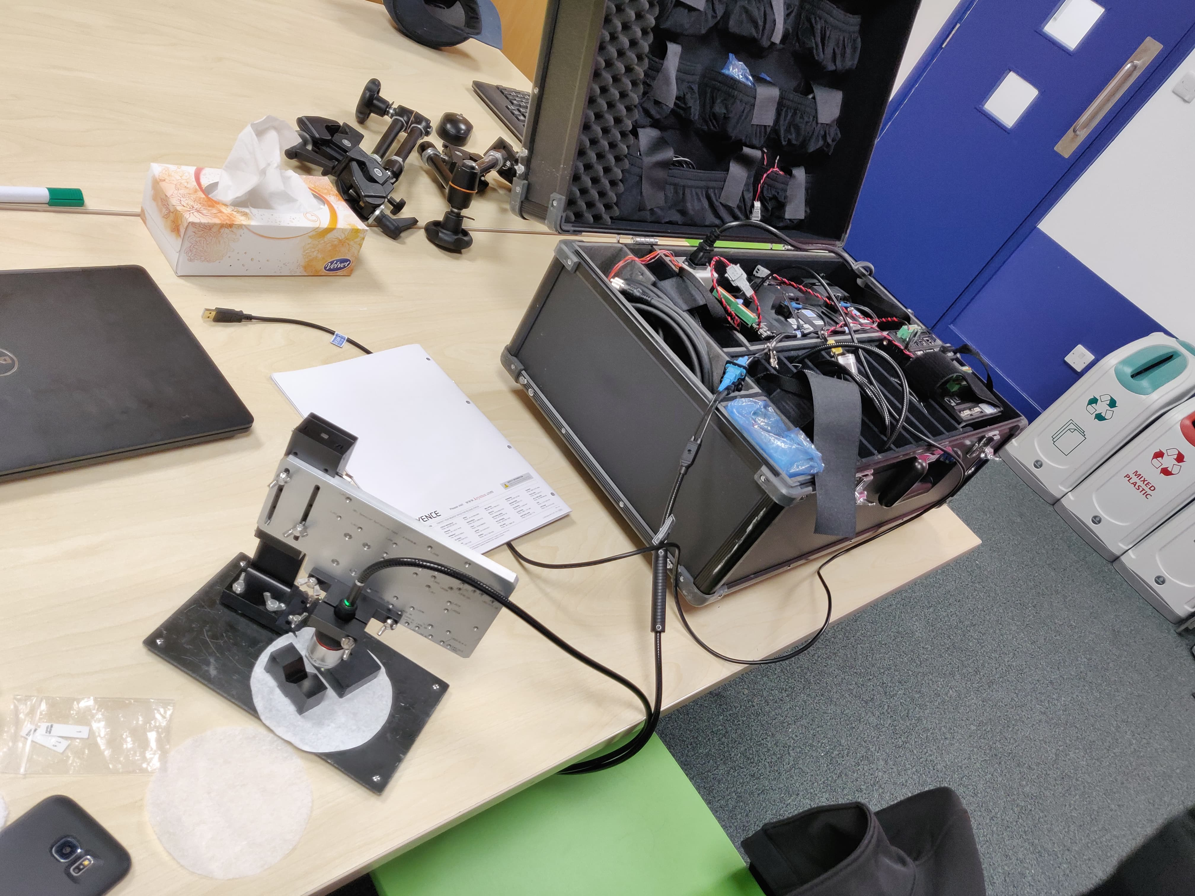
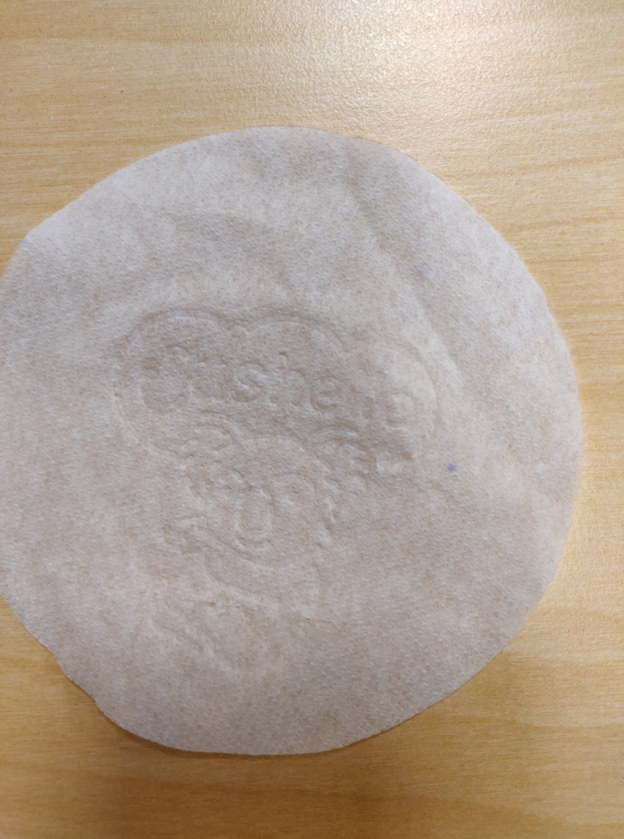

Slide 20

6. Pattern and Colour Recognition
6.1 Pattern/emboss Detection
Currently another essity site uses an external company to detect emboss on the sheets.
With the technology moving forward and the company pushing in industry 4.0, it was discussed this system could be developed internally as it would be much cheaper.
A Raspberry Pi and the Pi Camera were bought to test the idea.
A strobe was then used to match the frequency of the reel. A pattern was then able to be shown using the pi camera.

Slide 21
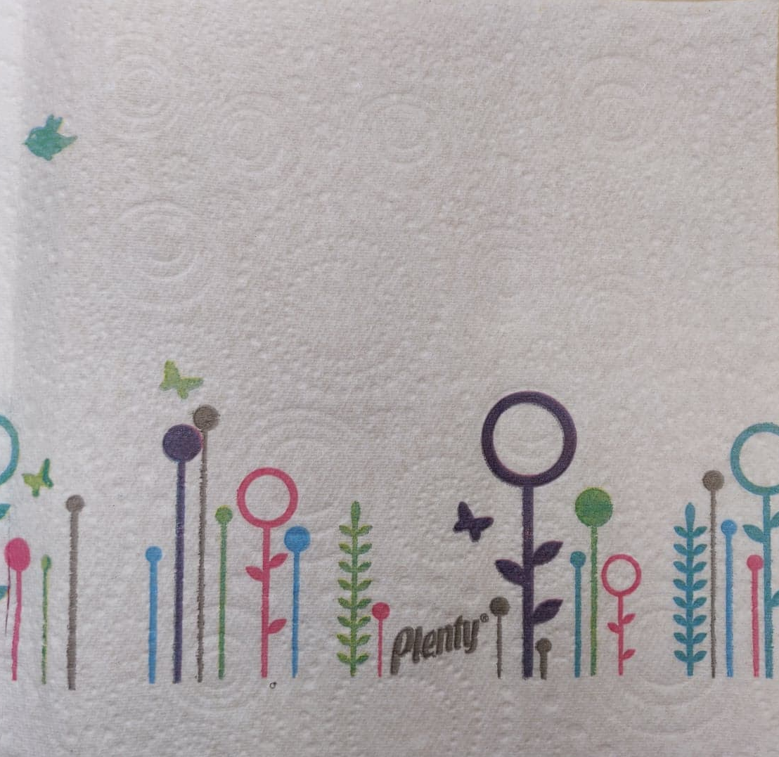
6. Pattern and Colour Recognition
6.2 Colour Recognition
Some of the products being produced have colour designs on them.
To apply the same principle as the pattern/emboss detection the pi and the camera were too slow for it.
Structural Similarity Measure a library from OpenCV came across to use for this task.
This program compares two images and gives a number between -1 and 1. 1 indicated perfect similarity and -1 means the image is no where similar to the original image.

Slide 22
7. Spool Recognition in paper making
Spools are large metal roads on the paper machine that are used to wind up the produced paper.
Each spool has a unique property such as its weight and friction.
This means that machine settings need to be adjusted for each spool. However, currently the machines control system does not know which spool is currently in use and so the general settings are used.
A system was already developed by another intern to do this task, however it needed to be started up at the station and access to all the peripherals was required.
It was found that the pi can be set up so that the program starts running as soon as the pi is switched on.
These settings were implemented, and the software was running as soon as the pi was connected to power and no peripherals were thus required.

Slide 23
8. Training of apprentices
Introduction of raspberry pi’s on the site required maintenance and troubleshooting if anything went wrong.
given the responsibility to train the apprentices with basic python knowledge for them to troubleshoot in case anything goes wrong.
Python training sessions were held once a week for fourteen weeks.
This was also key as the projects mentioned in 6 would not be completed in time the interns left. The foundation of the projects will be set out and the apprentices could continue it if the company decides it is worthwhile.

Slide 24
Company Events
The company organized two main events over the year. A goal deployment day and a Christmas night out.
At the goal deployment day presentations by key members were carried out to summarize previous year and set goals for the next.
It also involved team building exercises structured around the understanding of other departments.
The Christmas night out was a team building event where employees got a chance to socialise at a pub before heading out to the company dinner.
Multiple fundraisers were organized by human resources, such as cake sales, charity runs and even tough mudder. The money raised was donated to different organizations which were picked by the people working at the site through voting.

Slide 25
Conclusion
My time at essity started out slow with the initial project coming to a dead end as it did not meet company requirements even after an external company was called upon.
However tasks carried out after the first few months were achievable and completed within the time period.
All the tasks carried out represent a different competence.
Team working, documentation, time keeping, knowledge sharing and problem solving were all carried out at the work place.

